Slide 1
RESEARCH PROJECT
PROJECT TITLE: E-COMMERCE COLLECTION SYSTEM
NAME: KIPNGENO DENNIS
ADMN NO:COM/031/20

Slide 2
INTRODUCTION
The proposed eCommerce system is an online platform that will enable businesses to sell products or services over the internet.
The project aims to offer a user-friendly interface where customers can easily register, browse products, add items to their cart, complete payment,track orders, and update their user profiles.
The project also focuses on empowering administrators with a robust admin panel that allows them to manage customer records, track orders, update order statuses and management of registered users and published products.

Slide 3
PROBLEM STATEMENT
Currently, customers face challenges in finding a reliable and user-friendly eCommerce website that offers a wide range of products with detailed information. They also struggle with a lack of order tracking and management options, making it difficult to stay updated on the status of their purchases.
Administrators lack an integrated system that enables them to efficiently manage customer records, track orders, and oversee product inventory. The existing solutions fall short in providing a comprehensive admin panel with detailed product management options and a clear overview of registered users and orders.

Slide 4
SOLUTIONS
Implement a responsive and intuitive user interface that facilitates easy navigation, product search, and purchase process.
Develop a robust order management system that allows customers to track their orders in real-time. Provide order status updates in-account dashboards.
Develop a feature-rich admin panel with tools for managing customer records, orders, and product inventory. Provide detailed insights and reports on sales performance, customer behavior, and inventory levels.

Slide 5
OBJECTIVES OF THE SYSTEM
Enhanced Customer Experience: The system aims to improve customer satisfaction by offering detailed product information, intuitive navigation, and efficient order management features.
Efficient Order Management: Streamline the order management process for administrators by providing a centralized admin panel with tools for managing customer records, tracking orders, and updating product listings.
Seamless Integration: Ensure seamless integration between frontend and backend functionalities to deliver a cohesive and intuitive user experience.
Set a new standard in the realm of online shopping platforms by delivering a scalable, adaptable, and user-centric solution that meets the evolving needs of the modern e-commerce landscape.

Slide 6
LITERATURE REVIEW
Previous solutions to address the challenges in e-commerce website development have varied in their approaches and effectiveness. Traditional e-commerce platforms often relied on proprietary software or custom-built solutions, which could be costly to develop, maintain, and scale. Open-source platforms such as Magento, WooCommerce, and Shopify emerged as popular alternatives, offering customizable solutions with built-in features for product management, order processing, and payment integration.
However, these solutions often lacked flexibility, scalability, and customization options, leading to the emergence of custom-built e-commerce websites using frameworks like Django, Laravel, and Ruby on Rails. Custom-built solutions provided businesses with greater control over the design, functionality, and performance of their e-commerce platforms but required substantial development expertise and resources.

Slide 7
SYSTEM DESIGN AND ANALYSIS
System Requirements
Functional Requirements
User Registration and Login
Product Catalog Management
Shopping Cart and Checkout Process
Non-functional Requirements
Performance: The system should be able to handle a significant number of concurrent users and process transactions efficiently
Usability: The system should have an intuitive and user-friendly interface.
Scalability: The system should be designed to handle increasing volumes of users, products, and transactions.

Slide 8
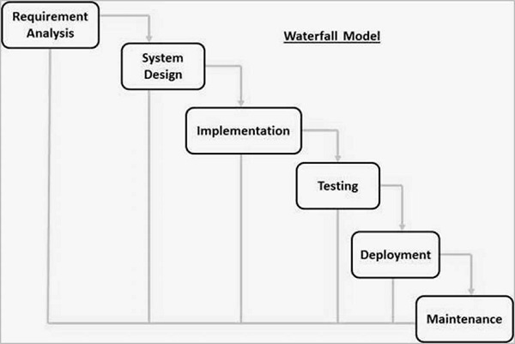
METHODOLOGY
Waterfall Model

Slide 9
WATERFALL MODEL
Waterfall methodology was chosen for its systematic and sequential approach and due clear understanding of project requirements.
Gathering and analyzing user requirements and project objectives.
Designing the system architecture, user interface, and database schema.
Coding and development of the platform based on the design specifications.
Quality assurance and testing to identify issues that must be resolved.
Deployment of the platform to production environment.
Maintenance is carried out to improve and enhance the system and its functionality.

Slide 10
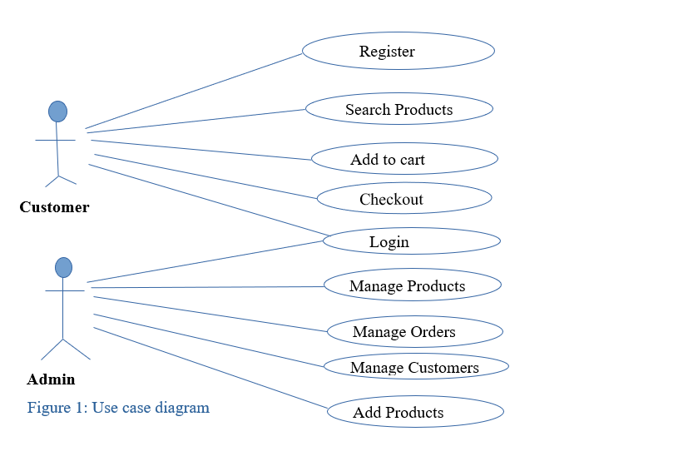
MODEL USED
Use Case Diagram

Slide 11
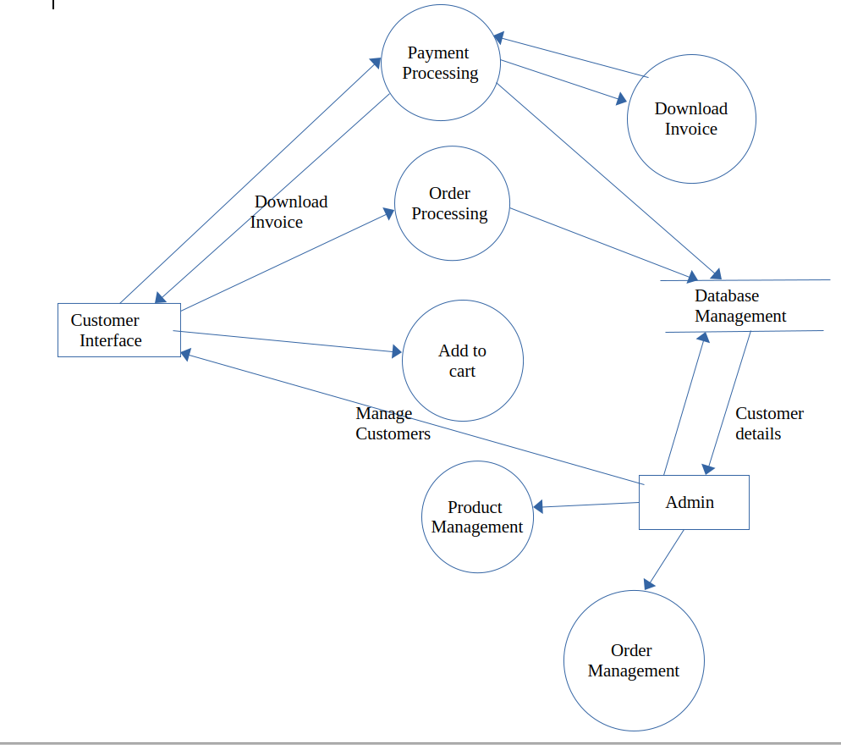
LEVEL- 1 DFD

Slide 12
JUSTIFICATION OF CHOICE
Adopting an iterative and user-centered design process, this ensures that the e-commerce system is tailored to the needs and preferences of the users.
Utilizing a participatory design approach, where users actively contribute to the design process, could ensure that the e-commerce system reflects the diverse perspectives and experiences of the target user base.
Applying an evaluation methodology, such as usability testing, this assess the effectiveness and efficiency of the e-commerce system.
Employing a mixed-methods evaluation approach, combining qualitative and quantitative data collection and analysis, would provide a comprehensive understanding of the e-commerce system.

Slide 13
DISCUSSION
Implementation Overview
Technology Stack: The e-commerce system was built using modern technologies such as Django for backend development, HTML, CSS for frontend development, JavaScript for both front-end and back-end, and SQLite3 for database management.
Security: Robust security measures, including data encryption, user authentication, and role-based access control, were implemented to protect user data and prevent unauthorized access. Uses CSRF (Cross-Site Request Forgery) token, which helps protect against malicious form submissions.
User Experience: The user interface was designed with a focus on usability, accessibility, and responsiveness, ensuring a seamless and enjoyable shopping experience for customers.

Slide 14
CONCLUSION
The development of the e-commerce system has been a significant success, resulting in a robust platform that enhances user experience, drives sales, and improves operational efficiency. By adhering to a structured development process and incorporating user-centric design principles, the system archieves its objectives of providing a seamless shopping experience for customers and empowering administrators with powerful management tools.

Slide 15
RECOMMENDATION
Continuous Improvement: Implementing a process for continuous improvement based on user feedback and performance analytics
Internationalization: Expanding the platform's reach by adding support for multiple languages, currencies, and regional preferences to cater to a global audience and increase market penetration.
Collaboration with Influencers and Partners:Partnering with complementary brands or influencers with a strong online presence can increase brand visibility and attract new customers.

